Slide 1
Standard User – Contracts Editor Features: Terms Tab
August, 2013

Slide 2

Learning Objectives
Upon completion of this course you will be able to:
Complete the Contract Terms tab
Modify a Term Value
Manage Term Grouping
Evaluate the Impact of a Term
View Term Revisions
Delete a Term
Add a Term

Slide 3
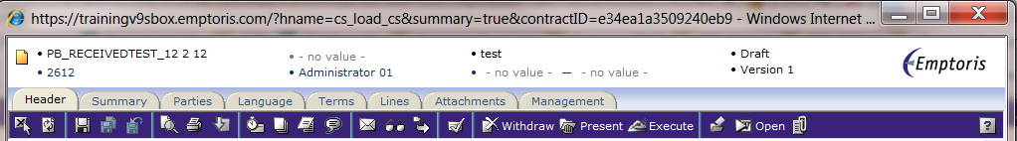
Contract Editor Toolbar and Tabs
The Contract Editor has several tabs and icons that you use to work on your contract. Tabs include:
Header tab: contains general information about your contract
Summary tab: displays a Management Summary; a single place to view key elements of the contract. This replaces cover sheets used for paper contracts and gives approvers a very clear summary of what the contract is about. It includes:
  Text area(s) to add additional information/summary about contract
  Terms
  Modified/replaced clauses – with or without the clause text
  Specific clauses
  Relationships
  Custom properties
  Activity – who reviewed this or who approved it
Parties: identifies the Internal Contact and External Party for the contract
Language tab: contains the contract language
Terms tab: contains the variable information and values defined by the template
Lines: applied to a Purchase or Sales Agreement and contains product/price information (not used)
Attachment tab: contains documents associated with your contract
Management tab: helps you manage the contract lifecycle (covered in later modules)
Notes:
NOTE: Performance tab is used in a module that COP chose not to purchase. Disregard that tab.

Slide 4
Terms Tab

Slide 5
Terms Tab
The Terms tab is where you can view or modify the contract terms. There are two types of terms:
  Language Terms: values that appear in the language or text of the contract and generally can be modified within the Language editor.
  Tracking Terms: values associated with the contract but are not part of the Language. They are used to ‘track’ contracts, generate reports, and search for or identify groups of contracts (such as “all contracts with a value over $1M”, or “all contracts written within the L48 Region”).
Terms can be created from two sources:
  System Terms: are values that come from some other part of the system (such as the Header or Parties tabs). They can be generated automatically by the system (e.g., the Contract Number) or entered as a part of another tab. System terms may appear in the Language but cannot be modified in the Language editor.
  User-Defined Terms: are terms that are defined by the Global Administrators to hold values that relate to the business or the contract type.

Slide 6
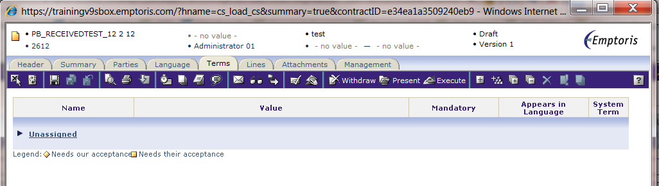
Terms Tab, cont.
Columns on the Terms Tab include:
Name: the ‘variable name’ the system uses for the term
Value: the current value of the term stored in the system for this contract instance
Mandatory: if the term must have a value before the contract is presented or executed or both
Appears in Language: if the term is a Language term and part of the Legal Language of the contract
System Term: if the term is a System term whose value is populated from some other part of ECM

Slide 7
“Unassigned” Term Group
Terms are organized into groups.
The Unassigned group contains the default terms defined in the Contract Template.
Click the small triangle icon next to the group name to display the terms in a group.
Note: The terms in all of the groups may be displayed or hidden using the Expand All and Collapse All icons on the far right side of the blue toolbar.

Slide 8
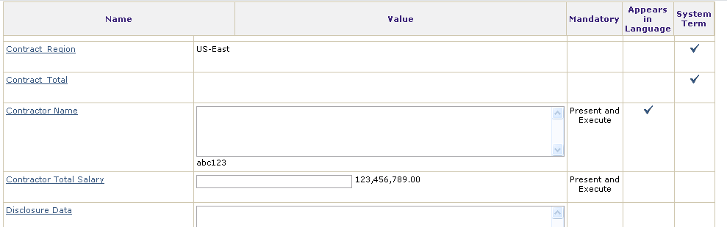
Term Values
Term values can be:
Populated automatically, as seen for the Contract Region term above; it is a System Term.
  The value is entered on the Header tab.
Entered into the Contract Language term values in the Language Tab.
Entered directly into the fields in the Terms tab. If the Contract Term is in the Language, it can be entered or edited on the Terms tab and will appear when viewing the Language in the Language tab.

Slide 9
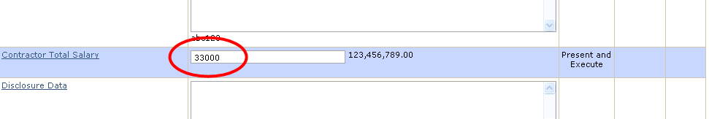
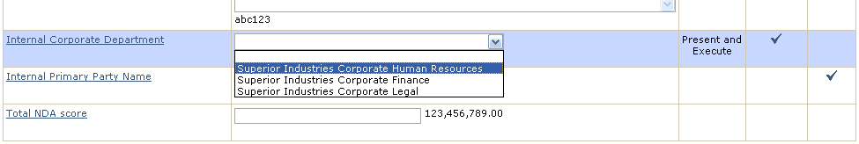
Modify a Term Value
To modify a term value:
Position the cursor in the value field next to the term name.
Enter the value for the term or select the value from a drop-down menu.
  Note: the small characters at the end of the input field provide guidance about the type of data expected in the term:
    Numeric (general, currency) – identified as 123,456,789.00
    Percent – identified as %
    Alphanumeric (text) – identified as abc123
Click in another Term field or click Save to save the entered value.

Slide 10

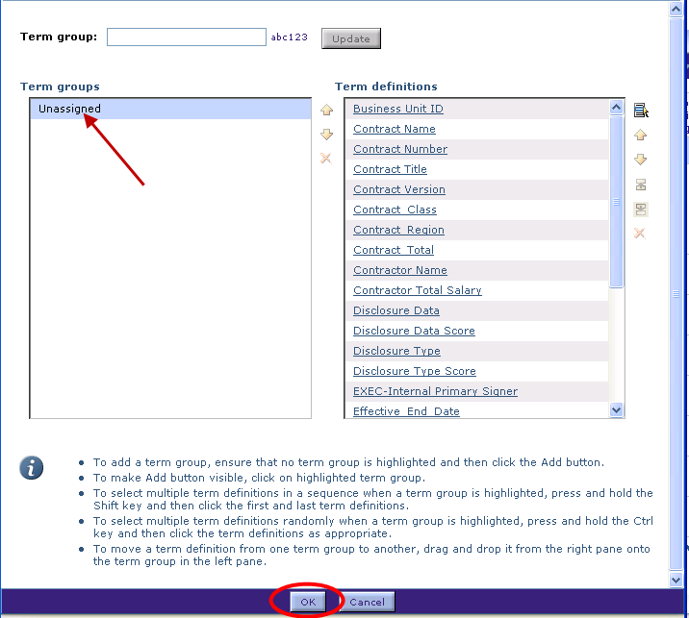

Manage Term Grouping
You can add other groups of terms or manage the groups that are part of the Contract template. Click the Manage Term Grouping icon.
The Term Grouping Dialog box is displayed.
To create a new group, enter a new
Group Term name and click the Add
button.
To edit the list of terms in a Group,
highlight the group name and use the
icons next to the Terms Definitions
panel to select other terms, change
the order of the terms, or delete
terms from the group (in which case
they are moved to Unassigned).
Click OK when finished.

Slide 11
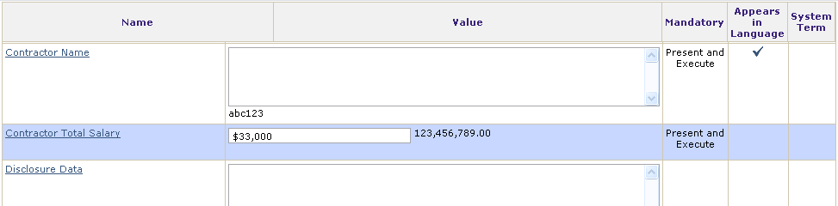

Delete a Term
To delete a term from the contract, click to highlight the term and click the Delete Term icon on the main blue toolbar.
The only terms that can be deleted here are user-defined terms that do not appear in language. Language terms can only be deleted on the Language tab or in the Word Editor.

Slide 12
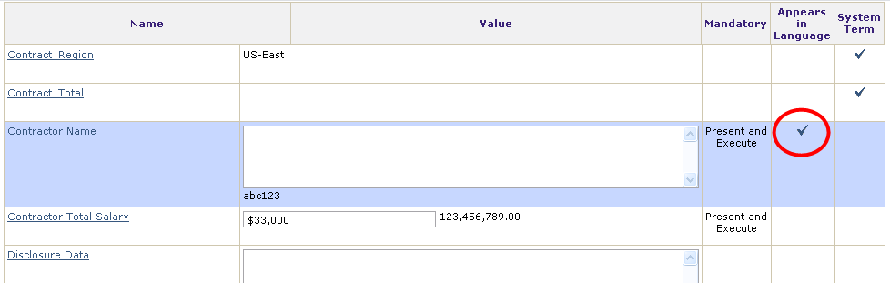

Evaluate Impact of a Term
Language terms may appear in multiple clauses. You may need to identify which clauses contain a specific term. This is called “Evaluating the Impact of a term”.
Click in the row to highlight a Language term
Click the Term Impacts icon on the far right side of the blue toolbar.

Slide 13
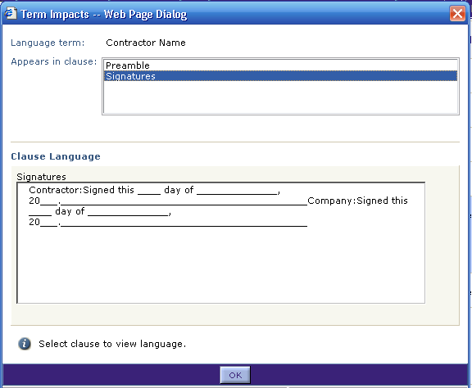
Evaluate Impact of a Term, cont.
The Terms Impact dialog box is displayed.
The top panel shows the list of clauses that contain the selected term.
Click a Clause Name to display the clause language in the bottom panel.
Click the OK button when done.

Slide 14
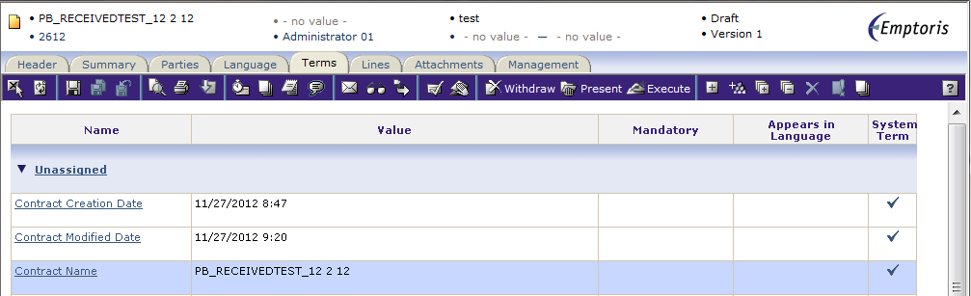
View Term Revisions
Contract Terms are variables and may have different values as the contract is created, modified or negotiated.
  Note that a change to a Language Term value is NOT considered to be a change to the containing clause(s), and is not reflected in Clause Revisions.
You can view the changes to the term value as the contract is revised.
Click in the row to highlight the term.

Slide 15
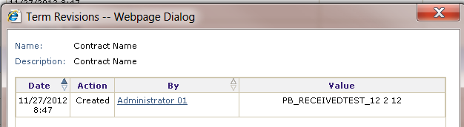
View Term Revisions, cont.
When a term is selected, the Term Revisions icon becomes visible in the upper right corner of the Terms tab. Click the icon to open the Term Revisions dialog box.
The history of revisions for that term is displayed.
  This appears in each revision of the contract, but NOT every time the term is changed.

Slide 16

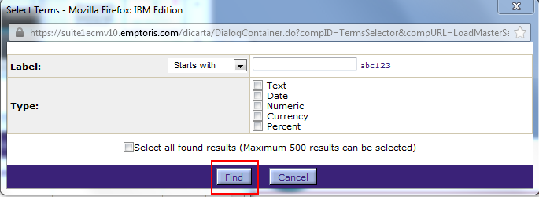
Add a Term
To add a term to a contract, click the Add Term icon (small plus sign).
The Select Terms dialog box is opened.
Enter search criteria for the term, or leave all the fields blank to display a list of all the available terms.
Click the Find button when done.

Slide 17
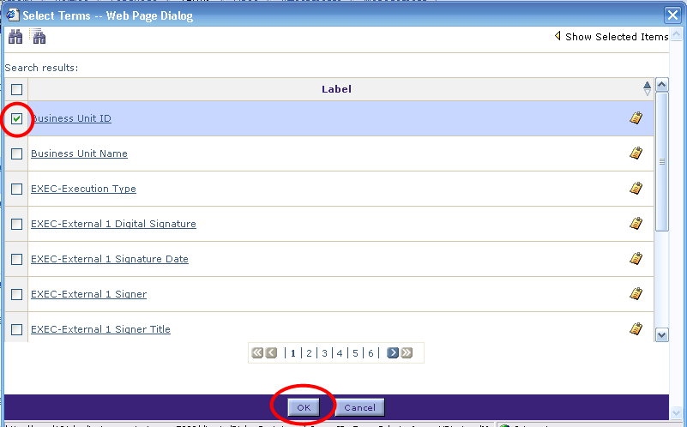
Add a Term, cont.
Use the page number or chevron arrow icons to navigate to the page with the term.
Click the check box for the term.
Click OK when done.

Slide 18
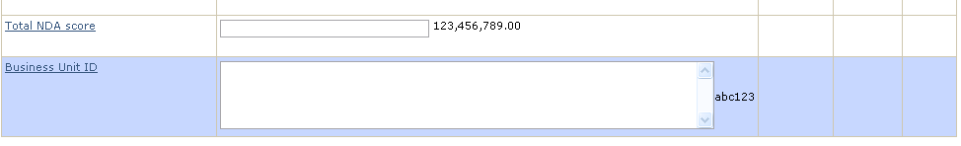
Add a Term, cont.
The selected Term is added to the Contract Terms tab.

Slide 19

Questions?

